Slide 1
VLIZ
Marine Robotics Centre
ERVO 2019

Slide 2
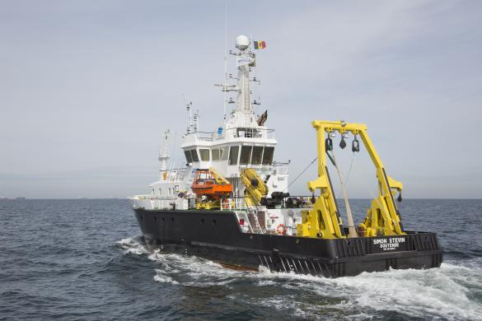
Existing Infrastructure
VLIZ
Length 36m
width van 9,4m
draft of 3,5m

Slide 3
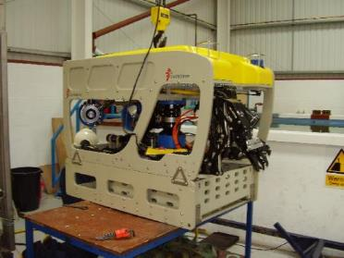
ROV Genesis
Inspection vehicle
color and high resolution video
Still camera system
Blueview scanning sonar
Hydraulic work arm

Slide 4
Marine Robotics
acquisition roadmap
April 2017 : feasibility study
May 2017 : call for large infrastructure investments
July 2017 : proposal for acquisition of AUV & USV
End 2017 : approval without any feedback/review
Total 3M€ + operations 300k€/yr
2018 publishing of tenders for both platforms & ordering
Early 2019 : delivery

Slide 5
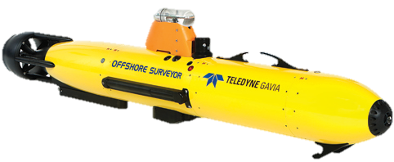
Teledyne Gavia
Marine Robotics Centre
Multibeam: Klein 3500 (455 kHz)
Sidescan sonar: Klein 3500 (455 en 900 kHz)
Sub-bottom profiler: Benthos (14 en 21 kHz)
Science bay module
CTD – RBR Legato
Oxygen– Aandera 4831
Chlorophyl, turbidity en CDOM – Wetlabs Ecopuck
Carbondioxide – Pro Oceanus mini
Nitrate – Wetlabs Suna
USBL – GAPS-transponder
ADCP: RDI workhorse (600 kHz)
Camera: Grasshopper GRAS-14S3M-C

Slide 6
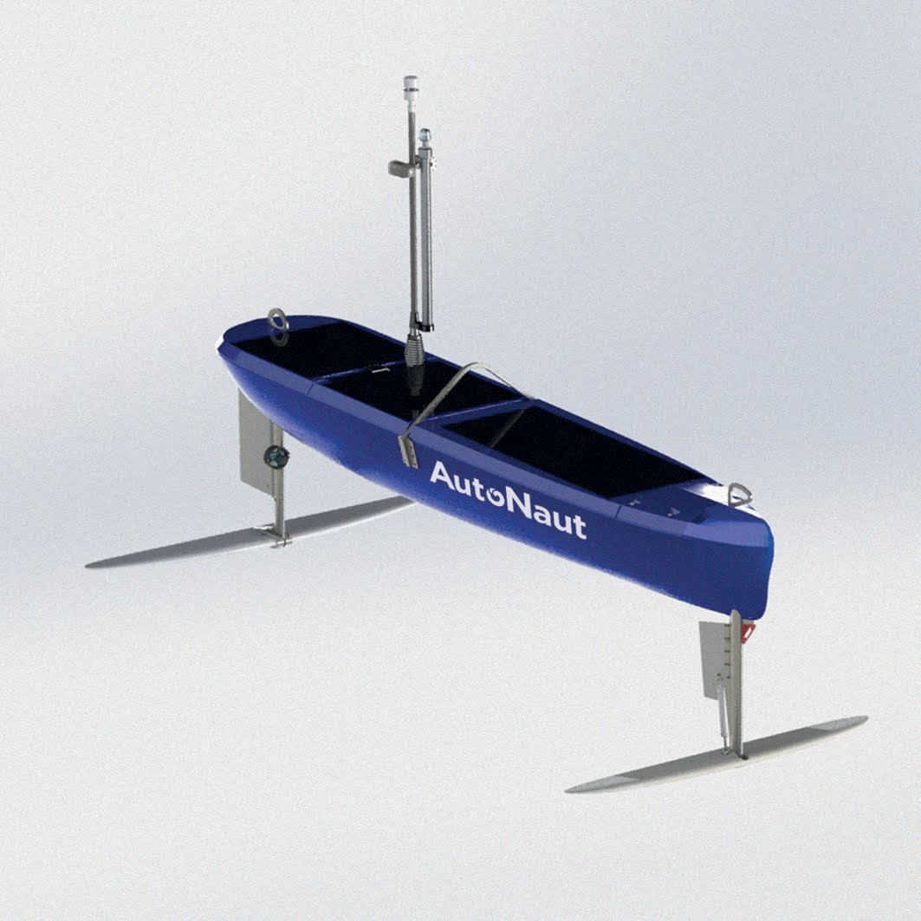
5m Autonaut
CTD – Seabird Fastcat
Chlorophyl a, turbidity, CDOM – Wetlabs Ecopuck
Oxygen – Aandera 4831
Webcam
ADCP – Teledyne RDI Workhorse 600 kHz
Acoustic receiver – Vemco V2RC mini
Wavesensor: Aandera MOTUS
Hydrophone: Seiche MicroPAM

Slide 7
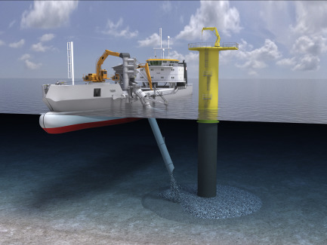
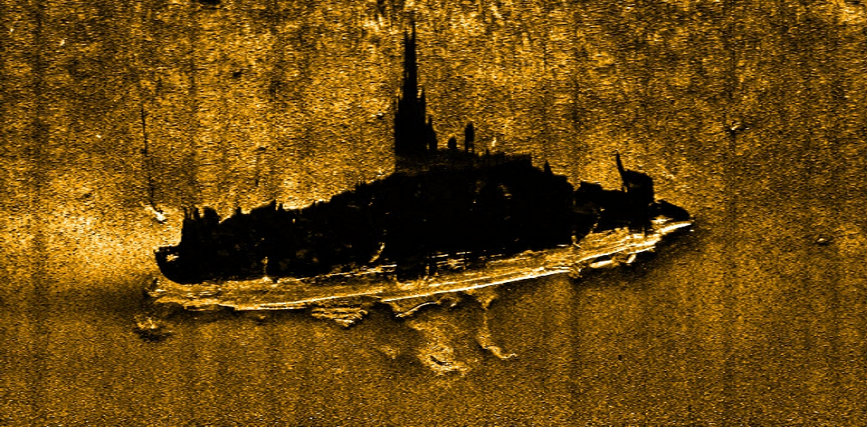
Geophysics & Geomorphology; Paleolandscapes & Habitatmapping
Wreck survey
Windfarm scour protection & sediment plume monitoring
Sedimentransport
Fish migration/behaviour
Seamammal observation
Sound environment
Biochemistry

Slide 8
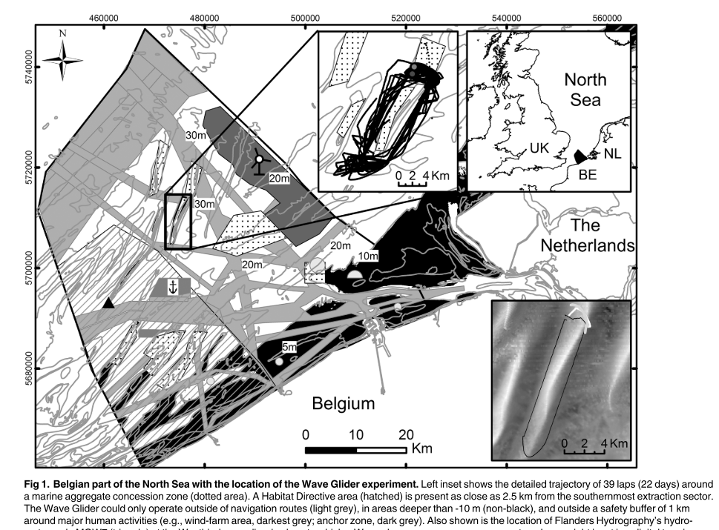
Using marine Robotics in Belgium

Slide 9
Using marine Robotics in Belgium
Collaboration on regulatory aspects of application on Autonomous Vehicles on the Belgian North Sea
Path towards AIS registration of remotely piloted research vessels
Community gathering and building

Slide 10
Vision
Facilitate access to new technologies for research and industry
Operational capacity to implement and test new technologies for research and industry
Facilitate cooperation between stakeholders in the community
Expose industry and research to cutting edge technologies
Promote access to technology for the entire community
Exercise and test regulations in the application of new systems
Aim
Place Belgium on the forefront of Autonomous Marine Operations and Systems in research and industry

Slide 11
Prof. Adhemar
Prof. Barabas
Prof. Zonnebloem

Slide 12
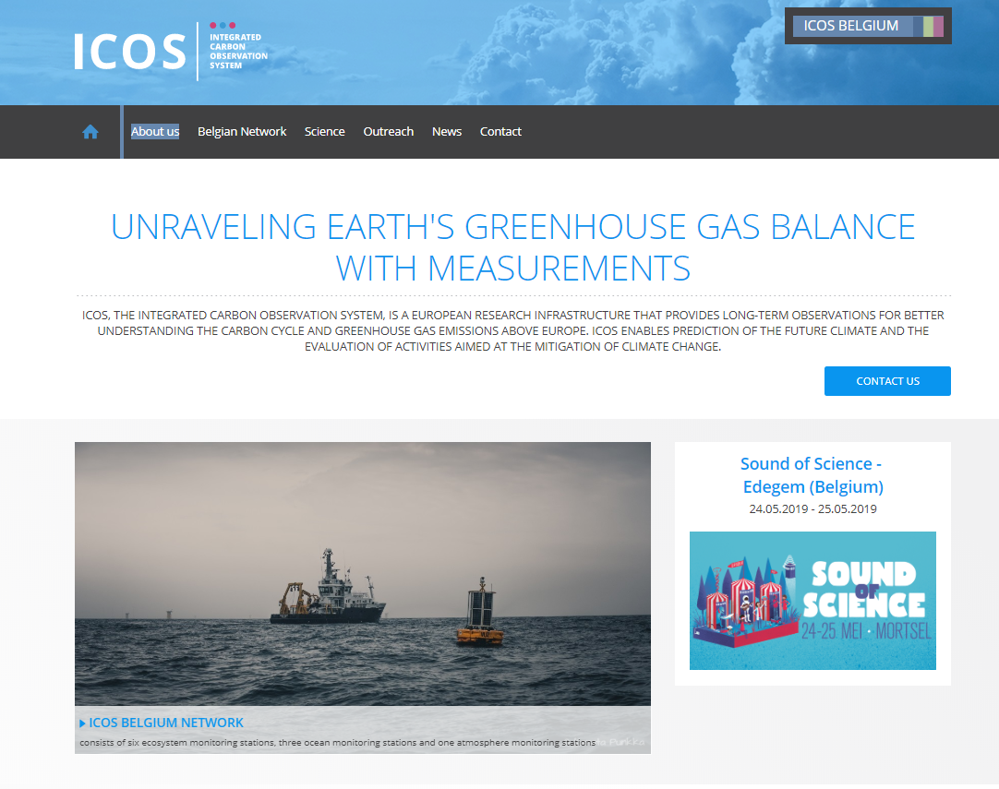
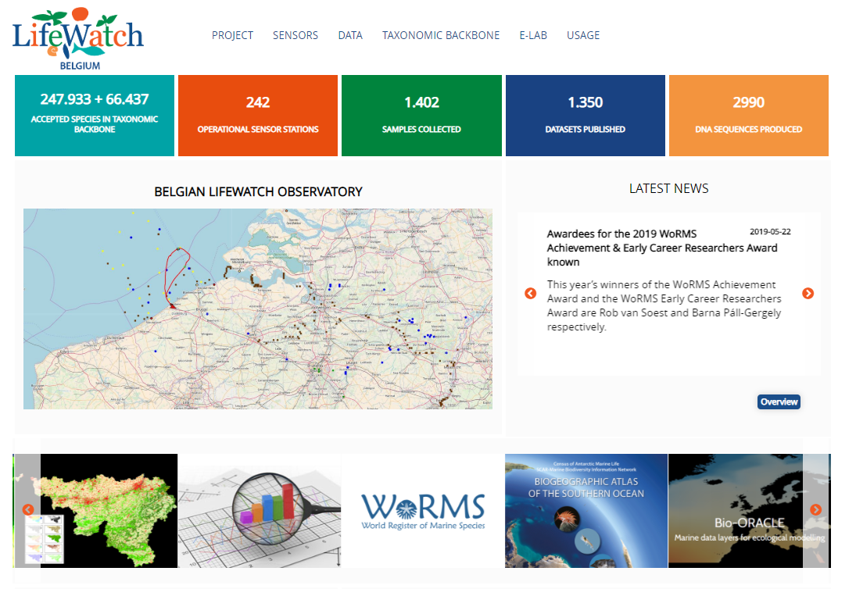
Existing Infrastructure
Simon Stevin
Observatories

Slide 13
FOD Mobiliteit en vervoer- VLIZ
Collaboration on regulatory aspects of application on Autonomous Vehicles on the Belgian North Sea
Path towards AIS registration of remotely piloted research vessels
Community gathering and building

Slide 14
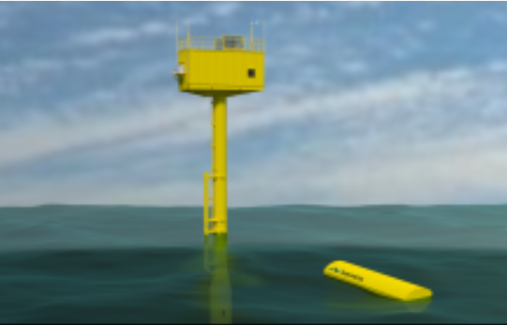
Existing Infrastructure
VLIZ
Simon Stevin
Observatories
Test platform at sea
Small craft and operations
Electronics lab
Scientific equipment
Expertise in Oceanography
….

Slide 15
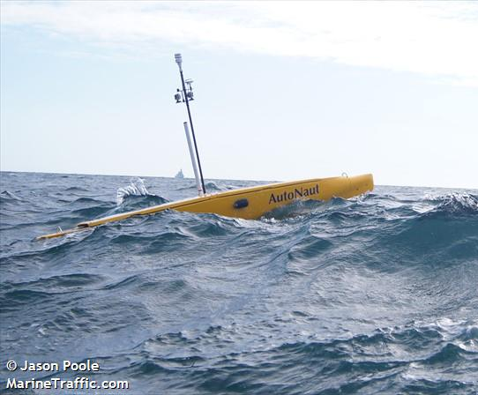
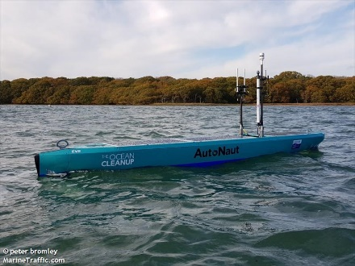
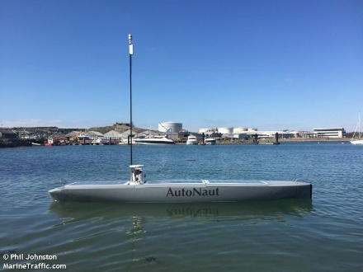
Autonaut
Naam | Omschrijving | Land | MMSI | Roepnaam
Autonaut Islay | marine | United Kingdom | 232005097 | MAHZ2
Autonaut USV Jura | pleziervaartuig | United Kingdom | 235116966 | 2JLR2
Autonaut EVE | pleziervaartuig | Netherlands | 244010009 | EVE
Autonaut Gordon | pleziervaartuig | United Kingdom | 235912161 | /

